Slide 1
Chapter 3
Financial Statement Analysis
Hillier, Fundamentals of Corporate Finance 4e

Slide 2
Chapter Overview
The Annual Report
Ratio Analysis
The Du Pont Identity
Using Financial Statement Information

Slide 3
The Annual Report

Slide 4
The Three Main Reports
Statement of Financial Position
The Income Statement
Statement of Cash Flows

Slide 5
The Statement of Financial Position
Also known as
The Balance Sheet
Assets =
Liabilities + Shareholders’ equity
Assets represent investments made by company
Liabilities and Equity represent how investments are financed

Slide 6
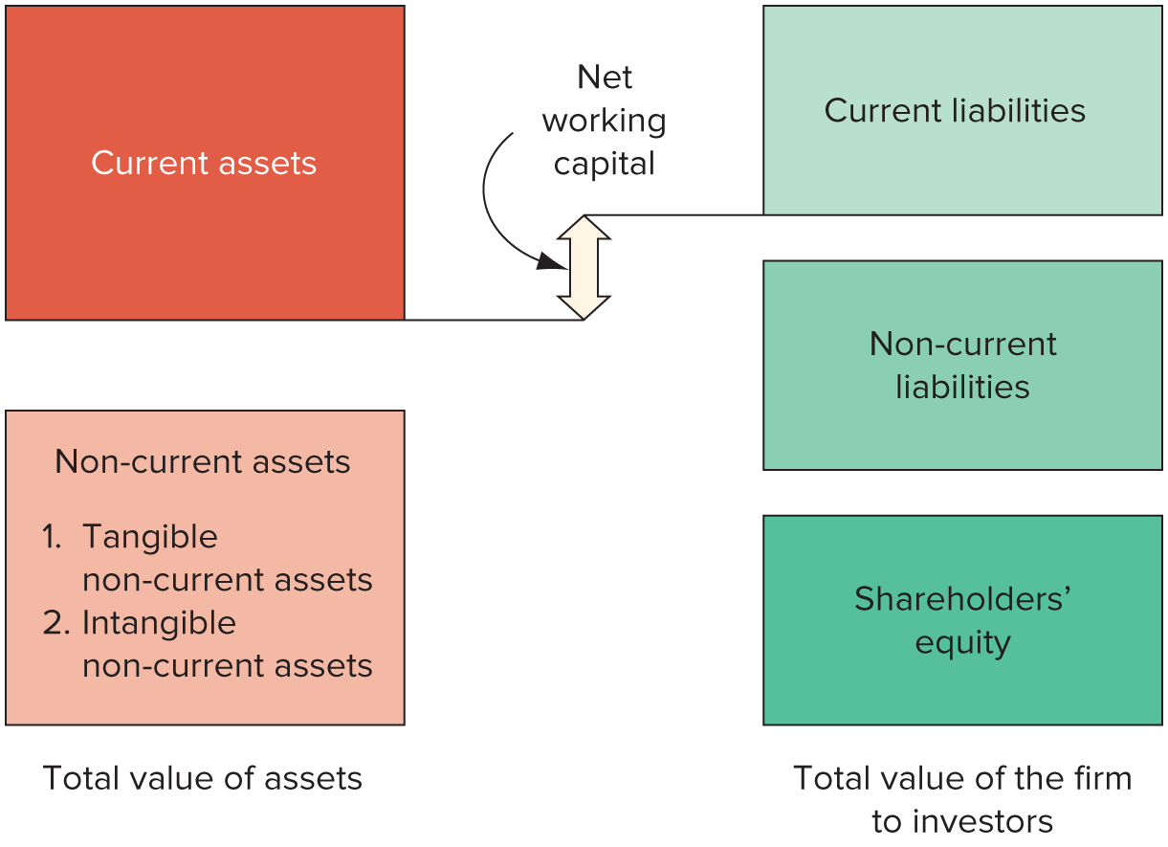
The Statement of Financial Position: Graphical Presentation

Slide 7
The Balance Sheet Equation
Liabilities
Equity
Assets

Slide 8
Net Working Capital
Net Working Capital =
Current Assets - Current Liabilities
It is important to ensure that net working capital is positive
Positive net working capital means that enough cash will be available to pay off liabilities arising

Slide 9
Market Values and Book Values
Book Value
Accounting Figures drawn from Accounting Standards
Market Value
Value based on prices or market valuations

Slide 10
The Income Statement
Measures performance over a specific period

Slide 11
The Income Statement Equation
Revenues
Expenses
Net Income

Slide 12
Income Statement: Important Considerations
Three Important Considerations
Non-cash Items
Time
Costs

Slide 13
Tax Rates
Average Tax Rates
This is the percentage of income that is paid in taxes
Marginal Tax Rate
The tax you would pay if you earn one more unit of currency
Average Tax Rate is the tax bill divided by your taxable income
Use this rate in any investment analysis because it is the rate that you would be taxed on any additional income

Slide 14
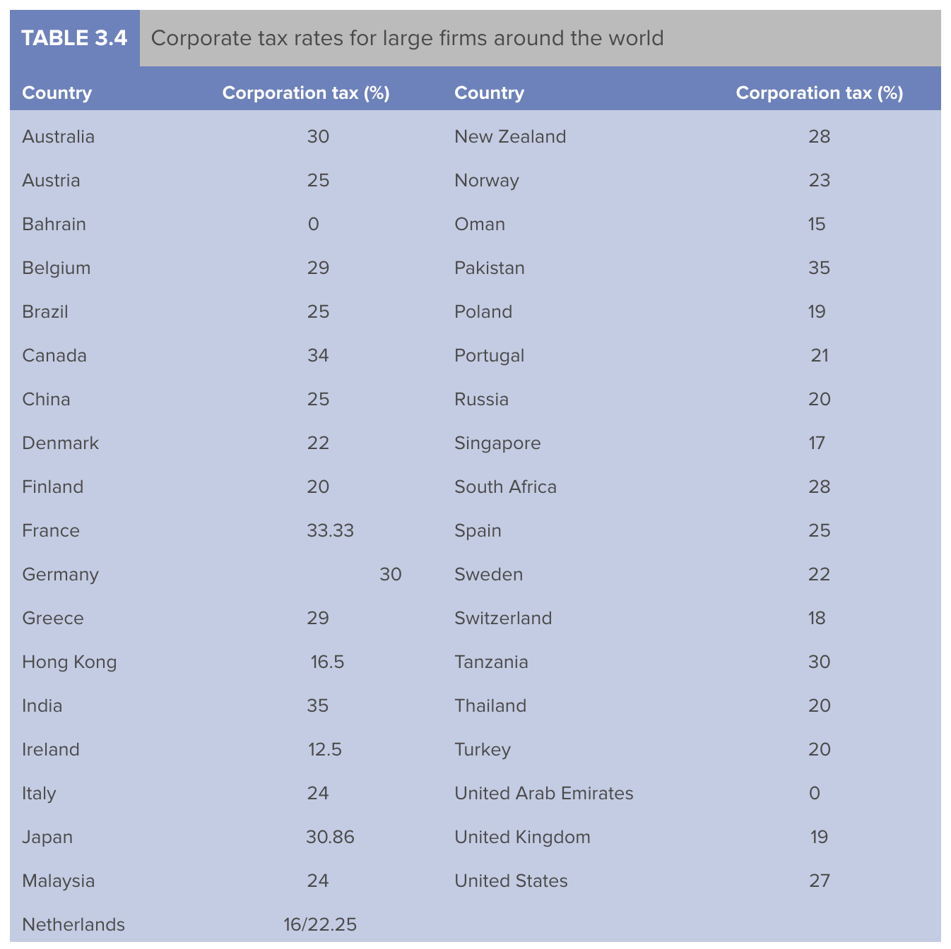

Slide 15
Statement of Cash Flows
Cash Flow is the most important item to take from financial statements
Cash Flow is NOT the same as Net Working Capital
Cash Flows from Assets = Cash Flows to Creditors and Equity Investors
Total Cash Flow comes from operating activities, investing activities and financing activities

Slide 16
The Cash Flow Equation
Net Cash Flow
Operating Cash Flow
Investing Cash Flow
Financing Cash Flow

Slide 17
Ratio Analysis

Slide 18
Why Undertake Ratio Analysis?
It is important to be able to analyze a firm’s financial statements and compare them to those of other firms

Slide 19
Ratio Categories
Liquidity Ratios
Financial Leverage Ratios
Turnover Ratios
Profitability Ratios
Market Value Ratios

Slide 20
Liquidity Ratios
Current Ratio = Current Assets
Current Liabilities
Quick Ratio = Current Assets – Inventory
Current Liabilities
Cash Ratio = Cash and Cash Equivalents
Current Liabilities

Slide 21
Financial Leverage Ratios
Total Debt Ratio = Total Assets – Total Equity
Total Assets
Debt-Equity Ratio = Total Debt
Total Equity
Equity Multiplier = Total Assets
Total Equity
Times Interest Earned Ratio = EBIT
Interest
Cash Coverage Ratio = EBIT + Depreciation
Interest

Slide 22
Turnover Ratios
Inventory Turnover = Cost of Goods Sold
Inventory
Days’ Sales in Inventory = 365 Days
Inventory Turnover
Receivables Turnover = Sales
Trade Receivables
Days’ Sales in Receivables = 365 Days
Receivables Turnover
Total Asset Turnover = Sales
Total Assets

Slide 23
Profitability Ratios
Profit Margin = Net Income
Sales
Return on Assets = Net Income
Total Assets
Return on Equity = Net Income
Total Equity

Slide 24
Market Value Ratios
Earnings per Share = Net Income
Shares Outstanding
Price-Earnings Ratio = Price per Share
Earnings per Share
Market-to-Book Ratio= Market Value per Share
Book Value per Share

Slide 25
The Du Pont Identity

Slide 26
Return on Equity
ROE is Affected by
Operating Efficiency
Asset Use Efficiency
Financial Leverage

Slide 27
The Du Pont Identity
Return on Equity = Net Income = Net Income x Assets
Total Equity = Total Equity Assets
= Net Income x Assets
Assets Total Equity
ROE = Sales x Net Income x Assets
Sales= Assets Total Equity
ROE = Net Income x Sales x Assets
Sales= Assets Total Equity
= Profit Margin x Total Asset Turnover x Equity Multiplier

Slide 28
How to Use Financial Statement Information
Time Trend Analysis
Looks at the same ratio over a number of years
Peer Group Analysis
Compares ratio with similar firms
Companies in same industry (Check SIC Code)

Slide 29
Financial Statement Analysis: Important Considerations
Inappropriate Peers
Some companies operate in several industries
Different Accounting Standards
Aspirant Analysis
You may want to compare your firm with the best in the industry
Choose similar firms at the top of the industry
Sources of Information
Financial websites: Yahoo! Finance, Reuters, FT.Com, ADVFN.com, Motley Fool
Company accounts: download from website

Slide 30
Concept Quiz

Slide 31
Why do firms present three different accounting statements?
Why might accounting revenue and cost figures not be representative of actual cash flows?
Why is the Du Pont identity a valuable tool for analysing firm performance?

